Slide 1
Pitcher Report
Interactive Dashboard
Carl Foust
Ted Zerbe

Slide 2
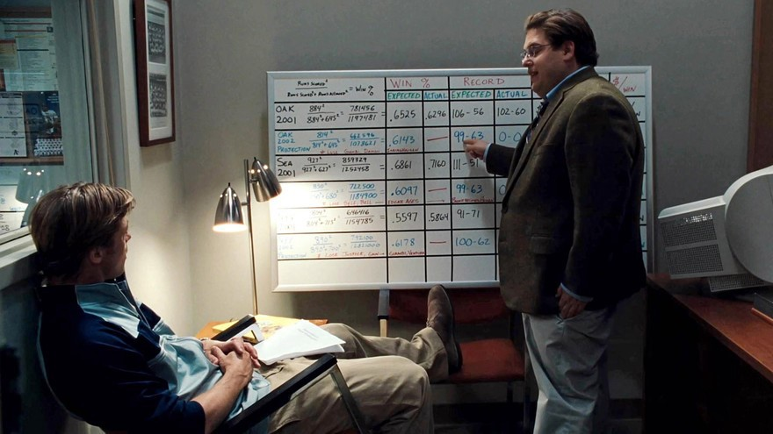
The Moneyball Movement
Low budget team
Traditional performance metrics fell short (AVG, ERA, eye test, etc.)
Used data to inform decision making and remain competitive

Slide 3
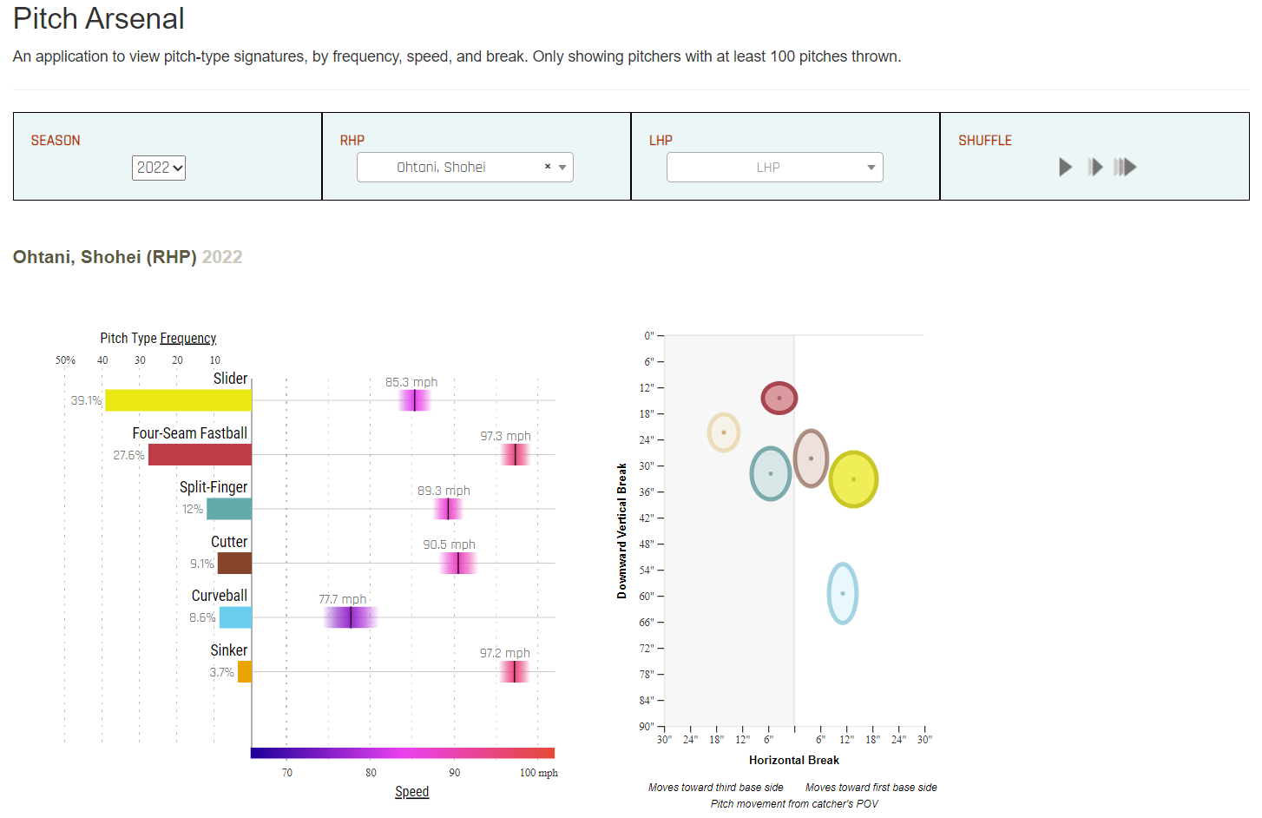
What is a Pitcher Report?
Summarizes basic characteristics of pitchers
Incorporates information such as the types of pitches thrown, how often they’re thrown, and specific metrics pertaining to each

Slide 4

How will we do this?
Create an interactive app using R Shiny
A package that allows us to make interactive web apps in R
Scrape and manipulate our data in R

Slide 5

Data - How We Found It
Scraped from Baseball Savant using baseballr
Includes many variables about each pitch
700,000+ pitches from the 2022 season
92 variables

Slide 6
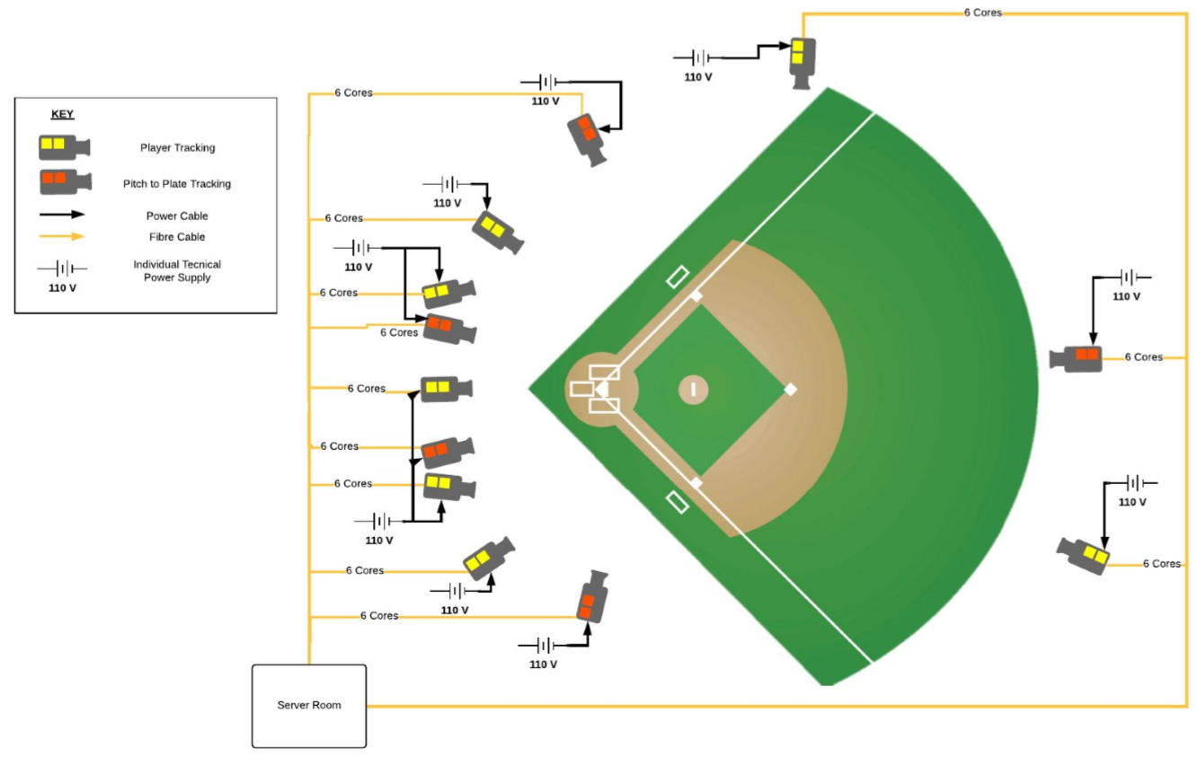
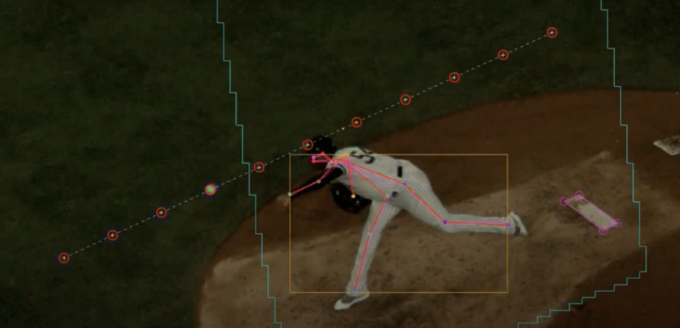
Data - What Is It?
Uses MLB Hawk-Eye ball tracking system
Records every on-field event with 12 cameras
Pitch movement, player positioning, etc.
Introducing Statcast 2020: Hawk-Eye and Google Cloud | by Ben Jedlovec | MLB Technology Blog (mlblogs.com)

Slide 7
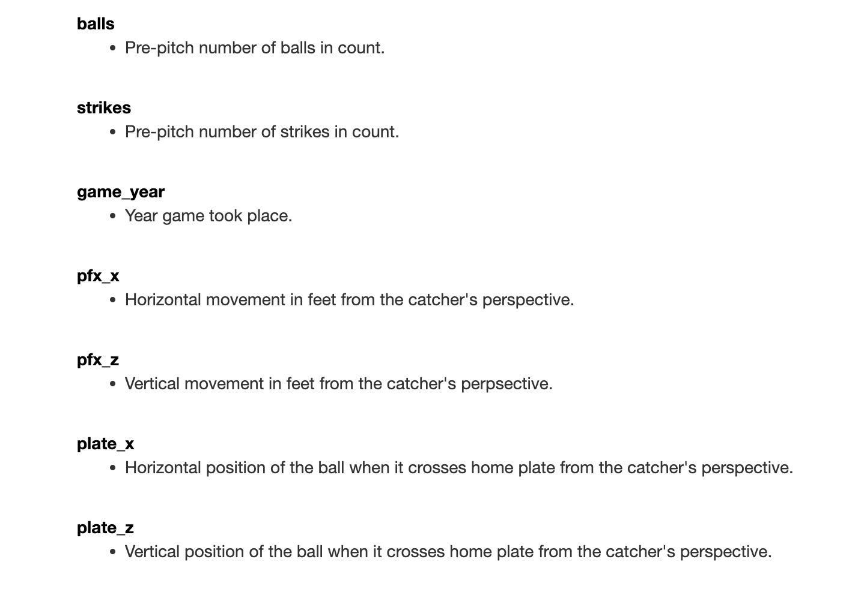
How Can This Be Used?
Pitch movement data and results data to help diagnose the quality of a pitch
Pitch location frequencies to detect patterns
Much, much more

Slide 8
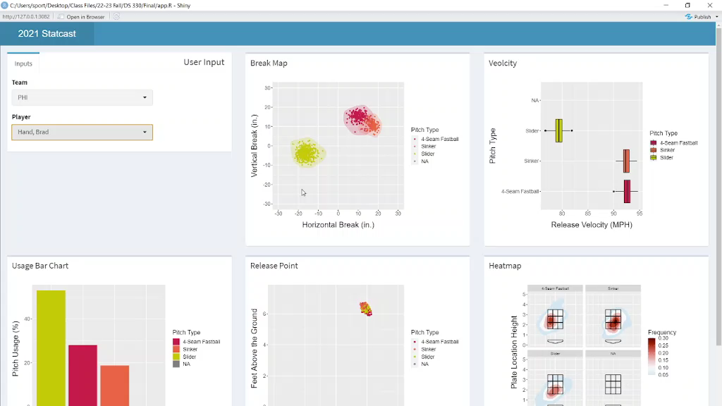

Slide 9
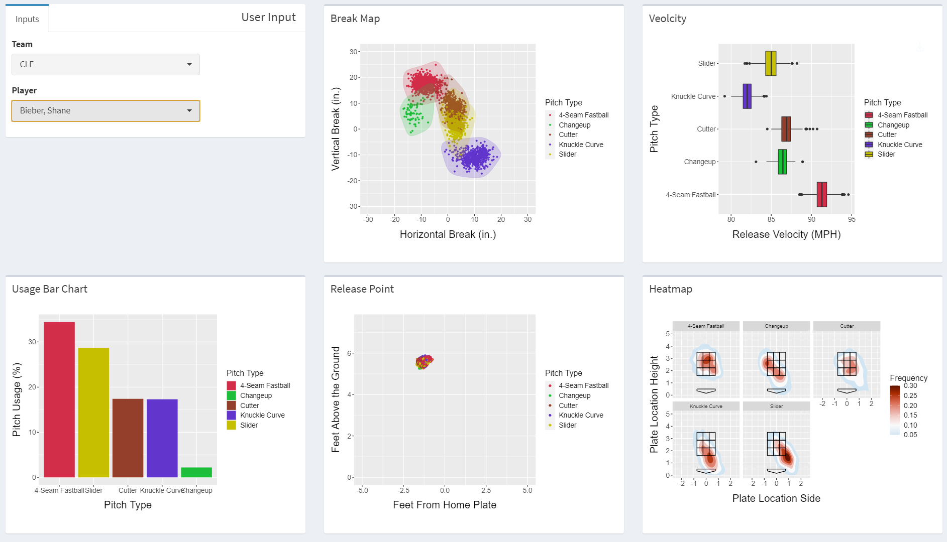

Slide 10
